Slide 1

Business Analytics Capstone
By: Ajin, Debanjana, Neil and Yash

Slide 2

The Business Problem
The success or failure of a business can hinge on its online reviews.
The problem is that a lot of fake restaurant reviews exist, and these reviews affect the business’s overall ratings, and diminishes their ability to achieve these goals
It is crucial for Yelp to be able to identify such fake or suspicious reviews immediately, and take corrective action, in order for it as a platform to stay relevant.

Slide 3
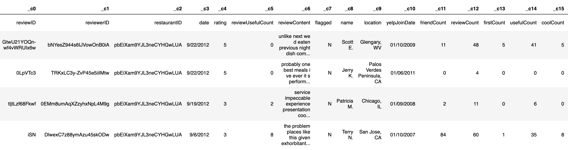
Dataset

Slide 4
Technical Analysis
EDA
Feature Engineering
Tokenization
Dimension Reduction
Model Building

Slide 5
Feature Engineering
Length of review in words
One-hot encoding for gender
Average word length of each review
Positive and negative words in a review
Number of Grammatical errors in a review
Duration between a user’s account creation date and the date the review was posted

Slide 6

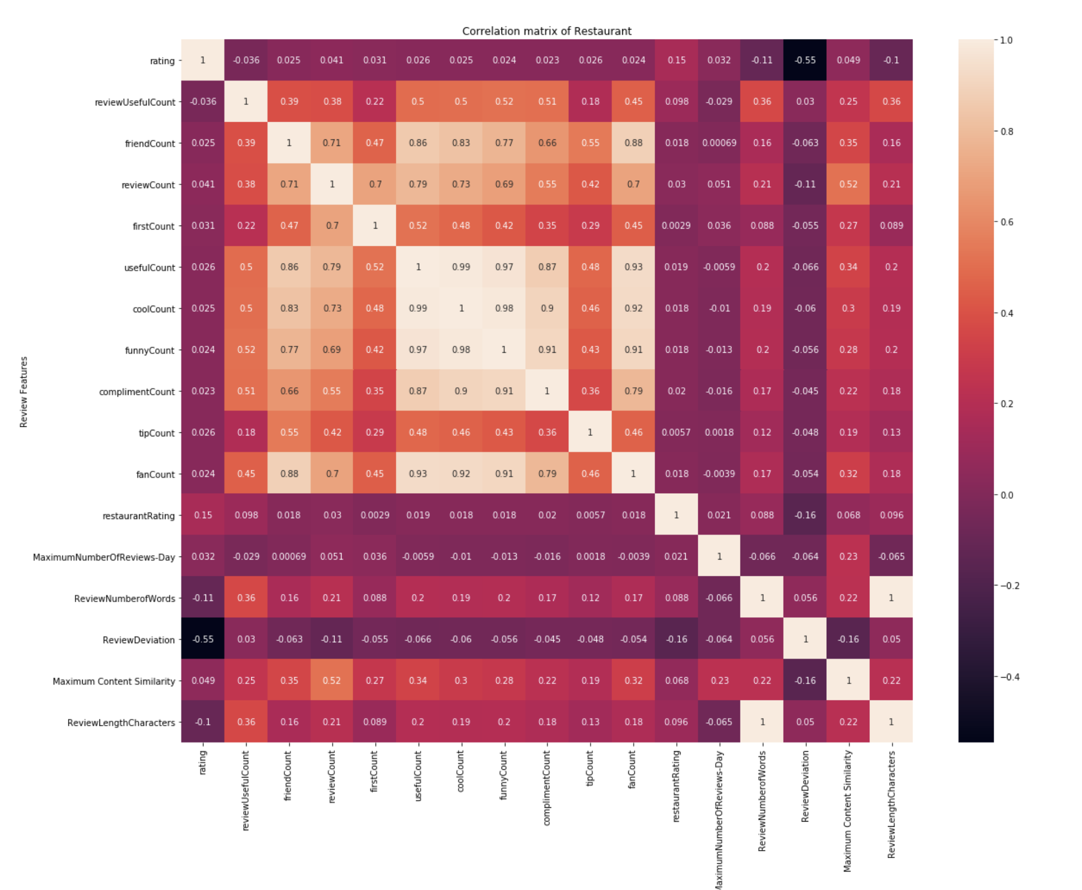
Correlation Matrix reviewcount usefulcount coolcount funnycount complimentcount tipcount fancount

Slide 7
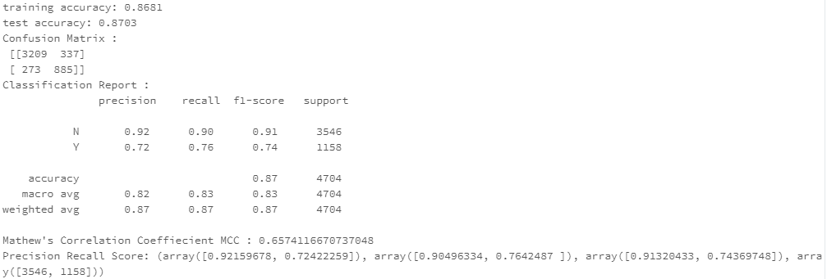
Model Building
Logistic Regression – Including all features

Slide 8
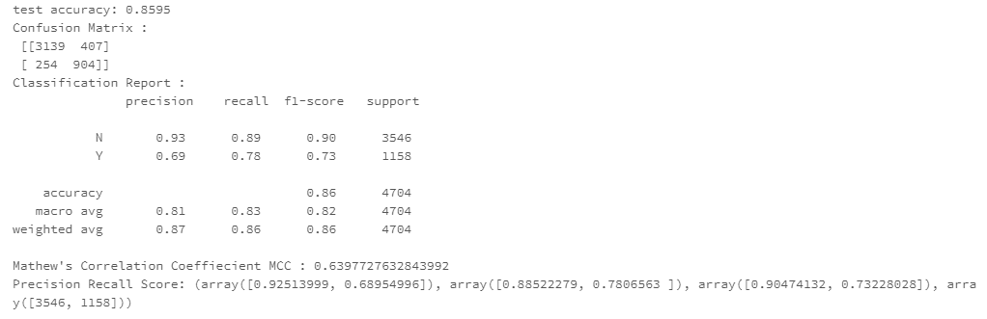
Model Building
Logistic Regression – Re-running model with top 10 largest positive & negative features

Slide 9
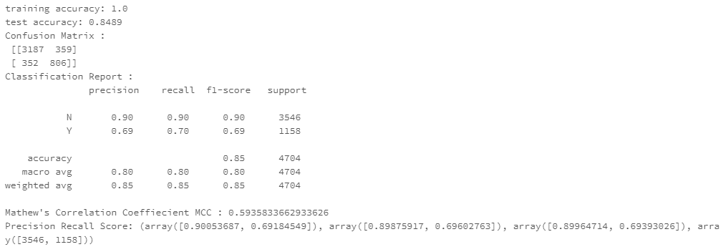
Model Building
Decision Tree– Including all features

Slide 10
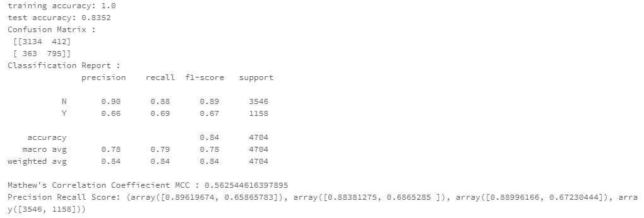
Model Building
Decision Tree– Re-running model with top 10 largest positive & negative features

Slide 11
Model Selection
Measures | Logistic Regression (All variables) | Logistic Regression (Top 20 variables) | Decision Tree (All variables) | Decision Tree (Top 20 variables)
Precision (Y) | 0.72 | 0.69 | 0.69 | 0.66
Precision (N) | 0.92 | 0.93 | 0.90 | 0.90
Recall (Y) | 0.76 | 0.78 | 0.70 | 0.69
Recall (N) | 0.90 | 0.89 | 0.90 | 0.88
F1 Score (Y) | 0.74 | 0.73 | 0.69 | 0.67
F1 Score (N) | 0.91 | 0.90 | 0.90 | 0.89
MCC Score | 0.66 | 0.64 | 0.59 | 0.56
Best Model : Logistic Regression with all variables

Slide 12
Conclusion
Model can be used for :
Determining fake vs real reviews
Help achieve better results & take corrective actions
Can be used for similar business problems
Build brand loyalty

Slide 13
Thank You

